Slide 1
15-441 Computer Networking
Lecture 4 – Applications
DNS, SSL

Slide 2
Outline
Security: Cryptography Introduction
Security: Authentication
Security: Key Distribution
DNS

Slide 3
What is Network Security?
Confidentiality: only sender, intended receiver should “understand” message contents
  Sender encrypts message
  Receiver decrypts message
Authentication: sender, receiver want to confirm identity of each other
Message Integrity: sender, receiver want to ensure message not altered (in transit, or afterwards) without detection
Access and Availability: services must be accessible and available to users

Slide 4



Friends and Enemies: Alice, Bob, Trudy
Well-known in network security world
Bob & Alice want to communicate “securely”
Trudy (intruder) may intercept, delete, add messages
Alice
Bob
channel
data, control messages
secure
sender
secure
receiver
data
data
Trudy

Slide 5
Who might Bob, Alice be?
… well, real-life Bobs and Alices!
Web browser/server for electronic transactions (e.g., on-line purchases)
On-line banking client/server
DNS servers
Routers exchanging routing table updates
Other examples?

Slide 6
There are bad Guys (and Girls) Out There!
Q: What can a “bad guy” do?
A: A lot!
  Eavesdrop: intercept messages
  Actively insert messages into connection
  Impersonation: can fake (spoof) source address in packet (or any field in packet)
  Hijacking: “take over” ongoing connection by removing sender or receiver, inserting himself in place
  Denial of service: prevent service from being used by others (e.g., by overloading resources)
more on this later ……

Slide 7

The Language of Cryptography
Alice’s
encryption
key
Bob’s
decryption
key
K_{A}
K_{B}
plaintext
encryption
algorithm
ciphertext
decryption
algorithm
plaintext
Symmetric key crypto: sender, receiver keys identical
Public-key crypto: encryption key public, decryption key secret (private)

Slide 8
Symmetric Key Cryptography
Substitution cipher: substituting one thing for another
  monoalphabetic cipher: substitute one letter for another
plaintext: abcdefghijklmnopqrstuvwxyz
ciphertext: mnbvcxzasdfghjklpoiuytrewq
E.g.:
Plaintext: bob. i love you. alice
ciphertext: nkn. s gktc wky. mgsbc
Q: How hard to break this simple cipher?:
  Brute force (how hard?)
  Other?
Notes:
26! Ways to do replacement

Slide 9
Symmetric Key Cryptography
K_{A-B}
K_{A-B}
plaintext
message, m
encryption
algorithm
ciphertext
decryption
algorithm
plaintext
K_{A-B} (m)
m = K_{A-B}(K_{A-B} (m))
Symmetric key crypto: Bob and Alice both know same (symmetric) key: K_{A-B}
e.g., key is knowing substitution pattern in mono alphabetic substitution cipher
Q: How do Bob and Alice agree on key value?

Slide 10

Public Key Cryptography
Symmetric Key Crypto
Requires sender, receiver know shared secret key
Q: How to agree on key in first place (particularly if never “met”)?
Public Key Cryptography
Radically different approach [Diffie-Hellman76, RSA78]
Sender, receiver do not share secret key
Public encryption key known to all
Private decryption key known only to receiver

Slide 11
Public Key Cryptography
+
Bob’s public
key
K_{B}
-
Bob’s private
key
K_{B}
plaintext
message, m
encryption
algorithm
ciphertext
decryption
algorithm
plaintext
message
+
K_{B} (m)
-
+
m = K_{B} (K_{B} (m))

Slide 12
Public Key Encryption Algorithms
Requirements:
+
-
1
Need K_{B}( ) and K_{B} ( ) such that
-
+
K_{B} (K_{B} (m)) = m
+
2
Given public key K_{B} , it should be impossible to compute private key K_{B}
-
RSA: Rivest, Shamir, Adelson algorithm

Slide 13
RSA: Another Important Property
The following property will be very useful later:
-
+
+
-
K_{B}(K_{B}(m)) = m
= K_{B} (K_{B}(m))
Use public key first, followed by private key
Use private key first, followed by public key
Result is the same!

Slide 14
Outline
Security: Cryptography Introduction
Security: Authentication
Security: Key Distribution
DNS

Slide 15
Authentication
“The Doors of Durin, Lord of Moria. Speak, friend, and enter.”
- Words on the gate to Moria
Password? → Mellon (Elvish for friend)
“Too simple for a learned lore master in these suspicious days. Those were happier times.”
- Gandalf

Slide 16
Authentication
Goal: Bob wants Alice to “prove” her identity to him
Protocol ap1.0: Alice says “I am Alice”
In a network,
Bob can not “see” Alice, so Trudy simply declares
herself to be Alice
“I am Alice”

Slide 17
Authentication: Another Try
Protocol ap2.0: Alice says “I am Alice” in an IP packet
containing her source IP address
Alice’s
IP address
“I am Alice”
Failure scenario??

Slide 18
Authentication: Another Try
Protocol ap2.0: Alice says “I am Alice” in an IP packet
containing her source IP address
Trudy can create
a packet “spoofing”
Alice’s address
Alice’s
IP address
“I am Alice”

Slide 19
Authentication: Another Try
Protocol ap3.0: Alice says “I am Alice” and sends her
secret password to “prove” it.
Alice’s
IP addr
Alice’s
password
“I’m Alice”
Failure scenario??
Alice’s
IP addr
OK

Slide 20

Authentication: Another Try
Protocol ap3.0: Alice says “I am Alice” and sends her
secret password to “prove” it.
Alice’s
IP addr
Alice’s
password
“I’m Alice”
Playback attack: Trudy records Alice’s packet
and later
plays it back to Bob
Alice’s
IP addr
OK
Alice’s
IP addr
Alice’s
password
“I’m Alice”

Slide 21
Authentication: Yet Another Try
Protocol ap3.1: Alice says “I am Alice” and sends her
encrypted secret password to “prove” it.
Alice’s
IP addr
encrypted
password
“I’m Alice”
Failure scenario??
Alice’s
IP addr
OK

Slide 22
Authentication: Another Try
Protocol ap3.1: Alice says “I am Alice” and sends her
encrypted secret password to “prove” it.
Alice’s
IP addr
encrypted
password
“I’m Alice”
Record
and
playback
still works!
Alice’s
IP addr
OK
Alice’s
IP addr
encrypted
password
“I’m Alice”

Slide 23
Authentication: Yet Another Try
Goal: avoid playback attack
Nonce: number (R) used only once-in-a-lifetime
ap4.0: to prove Alice “live”, Bob sends Alice nonce, R. Alice
must return R, encrypted with shared secret key
“I am Alice”
R
K_{A-B}(R)
Alice is live, and only Alice knows key to encrypt nonce, so it must be Alice!
Failures, drawbacks?
Notes:
Key distribution

Slide 24
Authentication: ap5.0
ap4.0 requires shared symmetric key
Can we authenticate using public key techniques?
ap5.0: use nonce, public key cryptography
“I am Alice”
Bob computes
R
+
-
-
K_{A}(K_{A}(R)) = R
K_{A}(R)
and knows only Alice could have the private key, that encrypted R such that
“send me your public key”
+
K_{A}
+
-
K_{A}(K_{A}(R)) = R

Slide 25
ap5.0: Security Hole
ap5.0 only as “secure” as the distribution of public keys
“I am Alice”
Bob computes
and authenticates Trudy
R
-
-
+
K_{T} (R)
K_{T}(K_{T}(R)) = R
“send me your public key”
+
K_{T}

Slide 26
Outline
Security: Cryptography Introduction
Security: Authentication
Security: Key Distribution
DNS

Slide 27
Trusted Intermediaries
Symmetric key problem:
How do two entities establish shared secret key over network?
Solution:
Trusted key distribution center (KDC) acting as intermediary between entities
Public key problem:
When Alice obtains Bob’s public key (from web site, e-mail, diskette), how does she know it is Bob’s public key, not Trudy’s?
Solution:
Trusted certification authority (CA)

Slide 28


Key Distribution Center (KDC)
Alice, Bob need shared symmetric key.
KDC: server shares different secret key with each registered user (many users)
Alice, Bob know own symmetric keys, K_{A-KDC} K_{B-KDC} , for communicating with KDC.
KDC
K_{A-KDC}
K_{P-KDC}
K_{X-KDC}
K_{P-KDC}
K_{B-KDC}
K_{Y-KDC}
K_{Z-KDC}
K_{A-KDC}
K_{B-KDC}

Slide 29
Key Distribution Center (KDC)
Q: How does KDC allow Bob, Alice to determine shared symmetric secret key to communicate with each other?
KDC generates R1
K_{A-KDC}(A,B)
Alice
knows R1
K_{A-KDC}(R1, K_{B-KDC}(A,R1) )
Bob knows to use R1 to communicate with Alice
K_{B-KDC}(A,R1)
Alice and Bob communicate: using R1 as
session key for shared symmetric encryption

Slide 30

Certification Authorities
Certification authority (CA): binds public key to particular entity, E.
E (person, router) registers its public key with CA.
  E provides “proof of identity” to CA.
  CA creates certificate binding E to its public key.
  Certificate containing E’s public key digitally signed by CA – CA says “this is E’s public key”
Bob’s
public
key
digital
signature
(encrypt)
+
K_{B}
+
K_{B}
CA
private
key
certificate for Bob’s public key, signed by CA
Bob’s
identifying information
-
K_{CA}

Slide 31
Certification Authorities
When Alice wants Bob’s public key:
  Gets Bob’s certificate (Bob or elsewhere).
  Apply CA’s public key to Bob’s certificate, get Bob’s public key
+
digital
signature
(decrypt)
Bob’s
public
key
K_{B}
+
K_{B}
CA
public
key
+
K_{CA}

Slide 32
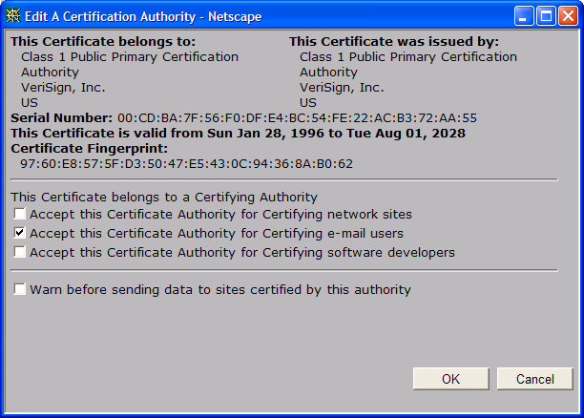
Certificate Contents
Serial number (unique to issuer)
info about certificate owner, including algorithm and key value itself (not shown)
Info about certificate issuer
Valid dates
Digital signature by issuer

Slide 33
Secure Sockets Layer (SSL)
Transport layer security to any TCP-based app using SSL services.
Used between Web browsers, servers for e-commerce (shttp).
Security services:
  Server authentication
  Data encryption
  Client authentication (optional)
Server authentication:
  SSL-enabled browser includes public keys for trusted CAs.
  Browser requests server certificate, issued by trusted CA.
  Browser uses CA’s public key to extract server’s public key from certificate.
Check your browser’s security menu to see its trusted CAs.

Slide 34
SSL (continued)
Encrypted SSL session:
Browser generates symmetric session key, encrypts it with server’s public key, sends encrypted key to server.
Using private key, server decrypts session key.
Browser, server know session key
  All data sent into TCP socket (by client or server) encrypted with session key.
SSL: basis of IETF Transport Layer Security (TLS).
SSL can be used for non-Web applications, e.g., IMAP.
Client authentication can be done with client certificates.

Slide 35
Network Security (Summary)
Cryptography (symmetric and public)
  Basic techniques & tradeoffs
Authentication
  Common styles of attack
Key distribution
  Why needed
…. used in many different security scenarios
  secure email, secure transport (SSL), IP sec, 802.11 WEP

Slide 36
Outline
Security: Cryptography Introduction
Security: Authentication
Security: Key Distribution
DNS

Slide 37
Naming
How do we efficiently locate resources?
  DNS: name → IP address
  Service location: description → host
Other issues
  How do we scale these to the wide area?
  How to choose among similar services?

Slide 38
Obvious Solutions (1)
Why not centralize DNS?
Single point of failure
Traffic volume
Distant centralized database
Single point of update
Doesn’t scale!

Slide 39
Obvious Solutions (2)
Why not use /etc/hosts?
Original Name to Address Mapping
  Flat namespace
  /etc/hosts
  SRI kept main copy
  Downloaded regularly
Count of hosts was increasing: machine per domain → machine per user
  Many more downloads
  Many more updates

Slide 40
Domain Name System Goals
Basically building a wide area distributed database
Scalability
Decentralized maintenance
Robustness
Global scope
  Names mean the same thing everywhere
Don’t need
  Atomicity
  Strong consistency

Slide 41
DNS Records
RR format: (class, name, value, type, ttl)
DB contains tuples called resource records (RRs)
  Classes = Internet (IN), Chaosnet (CH), etc.
  Each class defines value associated with type
FOR IN class:
Type=A
  name is hostname
  value is IP address
Type=NS
  name is domain (e.g. foo.com)
  value is name of authoritative name server for this domain
Type=CNAME
  name is an alias name for some “canonical” (the real) name
  value is canonical name
Type=MX
  value is hostname of mailserver associated with name

Slide 42
Hierarchical Name Space
Administrative hierarchy
  “.” as separator
Host name to address section
  Top-level domains → edu, gov, ca, us, etc.
  Sub-domains = subtrees
  Human readable name = leaf → root path
barracuda.cmcl.cs.cmu.edu
root
org
ca
net
edu
com
uk
gwu
ucb
cmu
bu
mit
cs
ece
cmcl
barracuda

Slide 43
DNS Design: Zone Definitions
Zone = contiguous section of name space
E.g., Complete tree, single node or subtree
A zone has an associated set of name servers
root
org
ca
net
edu
com
uk
gwu
ucb
cmu
bu
mit
Subtree
cs
ece
cmcl
Single node
barracuda
Complete Tree

Slide 44
DNS Design: Cont.
Zones are created by convincing owner node to create/delegate a subzone
  Records within zone stored multiple redundant name servers
  Primary/master name server updated manually
  Secondary/redundant servers updated by zone transfer of name space
    Zone transfer is a bulk transfer of the “configuration” of a DNS server – uses TCP to ensure reliability
Example:
  CS.CMU.EDU created by CMU.EDU administrators

Slide 45
Servers/Resolvers
Each host has a resolver
  Typically a library that applications can link to
  Local name servers hand-configured (e.g. /etc/resolv.conf)
Name servers
  Either responsible for some zone or…
  Local servers
    Do lookup of distant host names for local hosts
    Typically answer queries about local zone

Slide 46
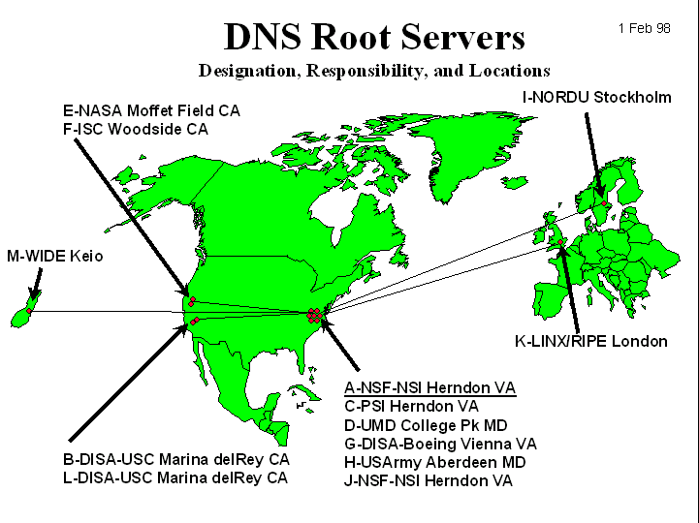
DNS: Root Name Servers
Responsible for “root” zone
Approx. dozen root name servers worldwide
  Currently {a-m}.root-servers.net
Local name servers contact root servers when they cannot resolve a name
  Configured with well-known root servers

Slide 47
Next Lecture
How DNS resolves names
How well does DNS work today
HTTP intro and details

